Slide 1

GAME DESIGN DOCUMENT (GDD)
Game Name: Space Traveller
Genre: Endless Runner
Game Elements:
Player:
The number of players that can play the game at once are for the moment only one. But with some help in our project we can make it available online.
TECHNICAL SPECS
Technical Form: It is a 3D game with regenerative surroundings.
View: Third person Viewing
Platform: PC
Language: C#
Device: PC
GAME PLAY: Our basic gameplay currently includes a airplane that has to dodge incoming buildings and avoid colliding into buildings. We currently have only one airplane model but we aslo intend to add more airplanes into the game.
Game Play Outline
This outline of our game is simple for begineers.
Opening the game application
Main Menu Screen pops up.
Click on the Play option and enjoy the game.
Set a high score by avoiding obstacles.
If you hit any obstacles you need to restart from 0 so be careful.

Slide 2
Key Features
Setting high records in a Endless Runner is the main goal of this game. Players can compete with others to set a high score as much as possible bringing a large audience, who have a motive to set high records in the game.
DESIGN DOCUMENT
Our game is a basic 3D endless runner but still has some complex mechanics with it to make it as real and enjoyable as possible.
Design Guidelines
The design is made keeing in mind that it has to be as difficult as possible to navigate through the course as Buildings keep on generating and are random. Also at the same time it needs to be entertaining for the user as well.
Game Design Definitions
The game dosent has particullarly levels in it but the difficulty of the game keeps on increasing. The airpalne speed and the speed of building generating keeps on getting quicker and nagivation becomes harder.
Game Flowchart
The game starts off always with the score as zero and keeps on increasing on the basis of distance covered. The game is an Endless Runner and hence has no end to it. The game cannot be completed but for sure high records can be set in the game. A player can set as many high records as they want to in as many times as possible. Winning and Losing can be decided by the amount of points they score in the game in one try.
Player Definition
Our player is an Spaceship as this is an Endless Space Runner.
The spaceship has collidors which can sense it being colliding into an Building and resulting in the spaceship being destroyed.
The spaceship also will constanlty increase in speed as the game progresses and as the player progresses in the score.
Player Definitions
Our Spaceship has no health.
It will automatically get destroyed as soon as it hits an Building.
It has no weapons for but we have plans to attach weapons and add enemies in the game.
Player Properties
Spaceship has speed property which keeps on increasing timely.
Spaceship can dodge obstacles.
Player Rewards (power-ups and pick-ups)
User can have rewards such as weekly top scorer and Topscorer of the Month and so on and so forth.

Slide 3
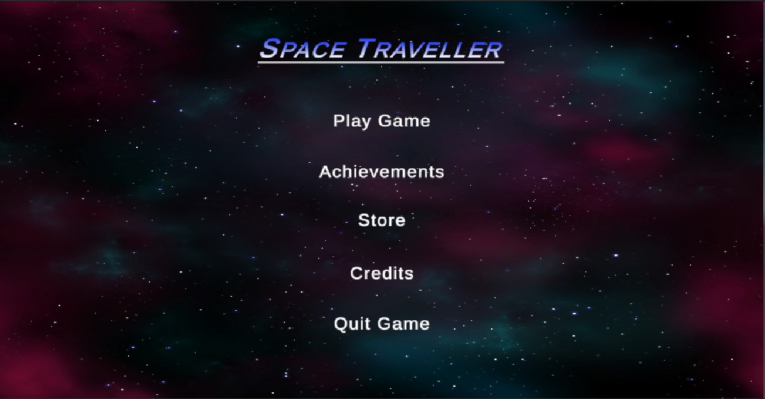
User Interface (UI) :
`We have done a fairly simple interface where a User can simply click on Play Game and get straight into the game. User now needs to dodge the incoming buildings and avoid crashing into them. If he crashes he is returned to the main menu. To make sure that the user is ready after hitting Play Game, he is given a 3 second countdown after which the game begins. The Achievements menu shows the hogh score of the User. Store will be displaying more aircrafts being added into the game.

Slide 4
• • • | Accessibility – the game controls are for time being only two keys. Left Arrow key to move the spaceship left and Right Arrow key to move the spaceship right.
 | Intent Communication – these controls provide the user with enough control over the spaceship to make him feel that they are actually driving it.
 | Expression Space – the game controls can be even more dynamic and even more features can be added which can be made sure.
Let’s look at these principles in more details.
Accessibility Hand Limitations
If we want our controls to be easy to use, the first thing that we need to take into
account is our hand limitations.
There are three main ―finger groups‖ that we need to keep in mind during controls
design:
• • • | Primary control – Right/Left Index Finger
 | Secondary control – Right/Left Ring Finger
 | Support – Currently Not Available
 | .
Let’s try to apply our knowledge of hands limitations for the more practical task – designing of the game controls layout. In order to do that, we can use a Fitt’s Law , which for our case we can formulate that way: ― t h e fewer the distance to the button and the bigger the button, the more accessible the button is.‖
Combining Fitt’s Law and knowledge of hand limitations, we can formulate the basic principle for controls layout design:
The most frequent actions should be in the most accessible places and match primary control group of the player’s hand.
Accessibility Tiers: Gamepad
For the gamepad, it might look like this (as an example, we can use very common Xbox 360 Controller):

Slide 5
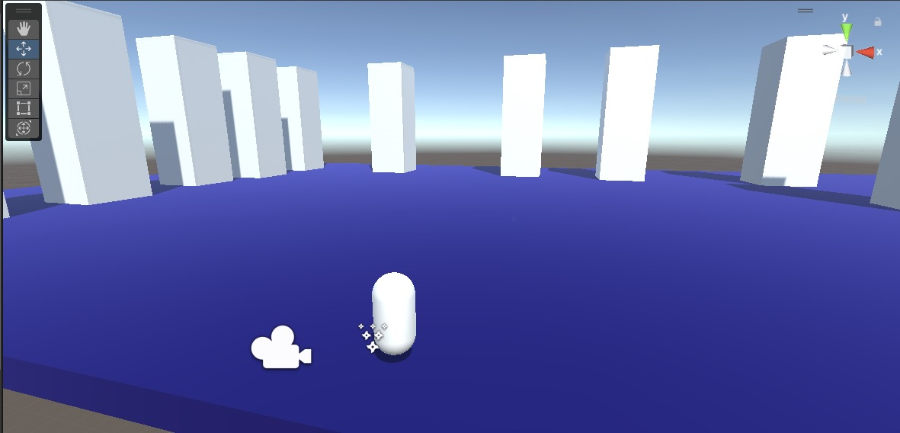
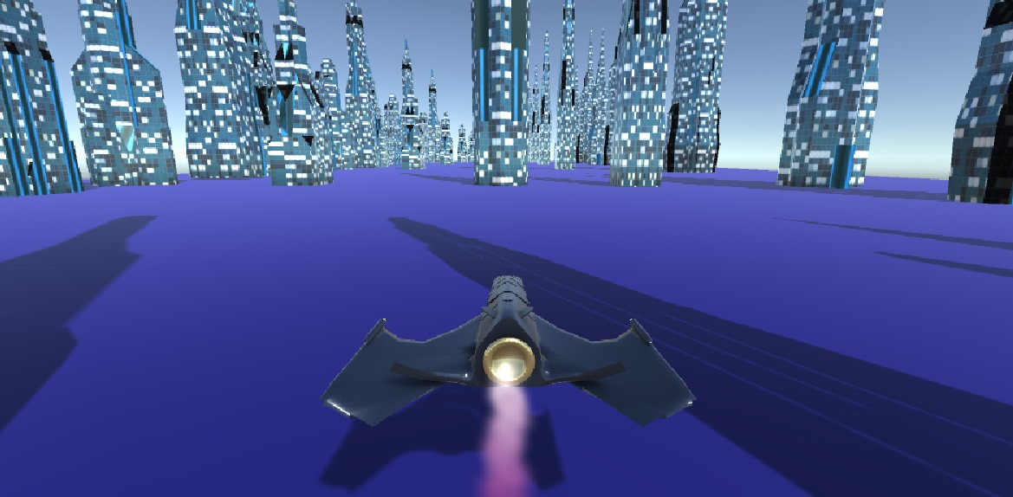
Accessibility Tiers: Keyboard
We have used Right and Left Arrow keys mainly for now as to direct the aricraft to avoid the buildings. While developing the game in its early stages the game looked something like this.
The White Cylinder like object was our spaceship whose assests were later developed by us and used in the game. The White Cuboid like buildings were also just some objects with collidors ON. The final assessts were made using Blender, which is an tool for assest creation in Unity. After the making of assest we added the assest into the game. After which the game looked like this.

Slide 6
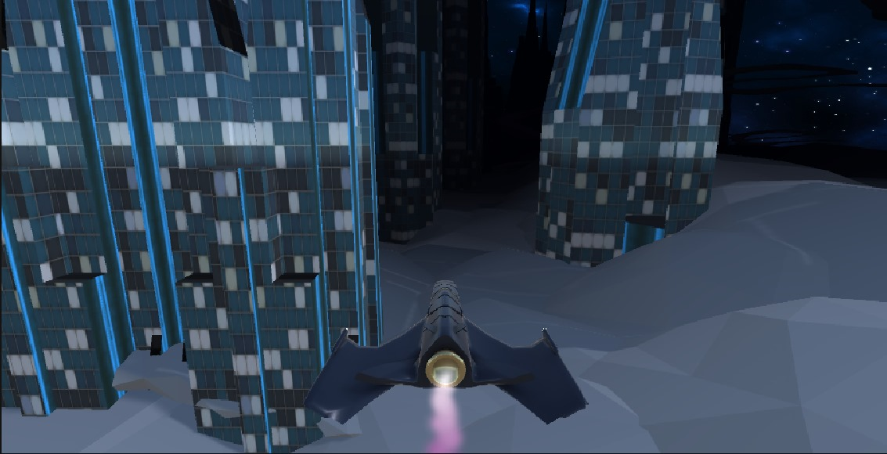
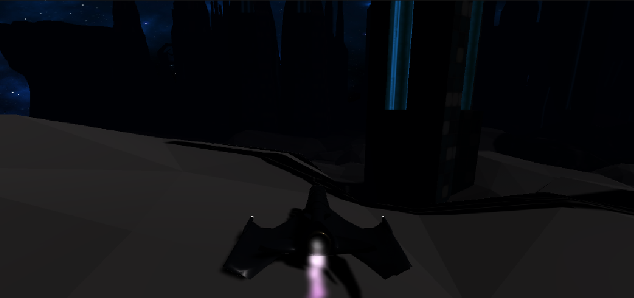
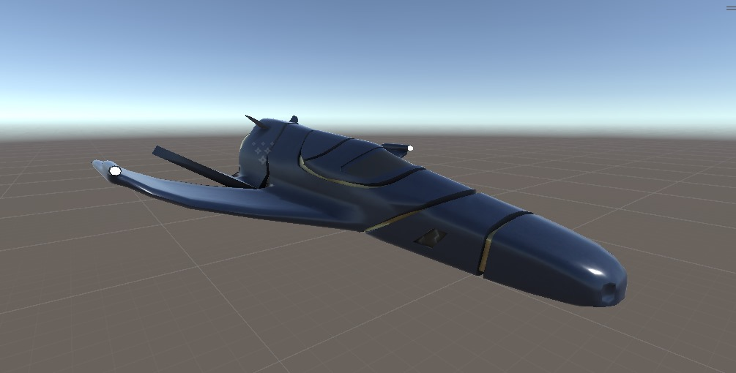
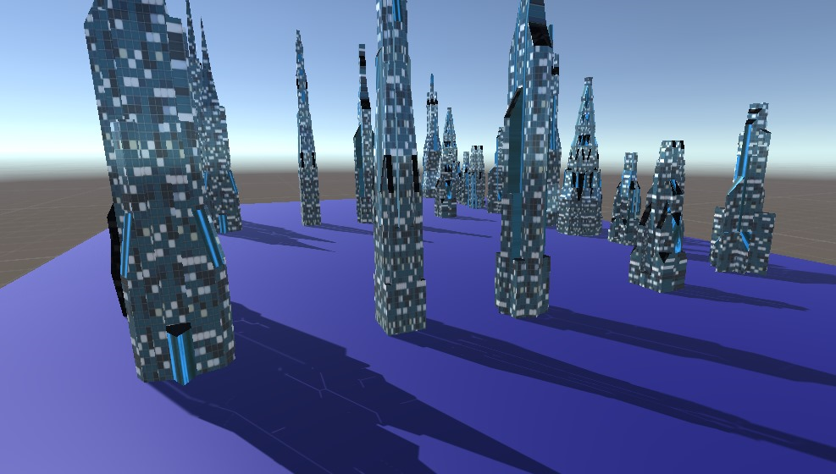
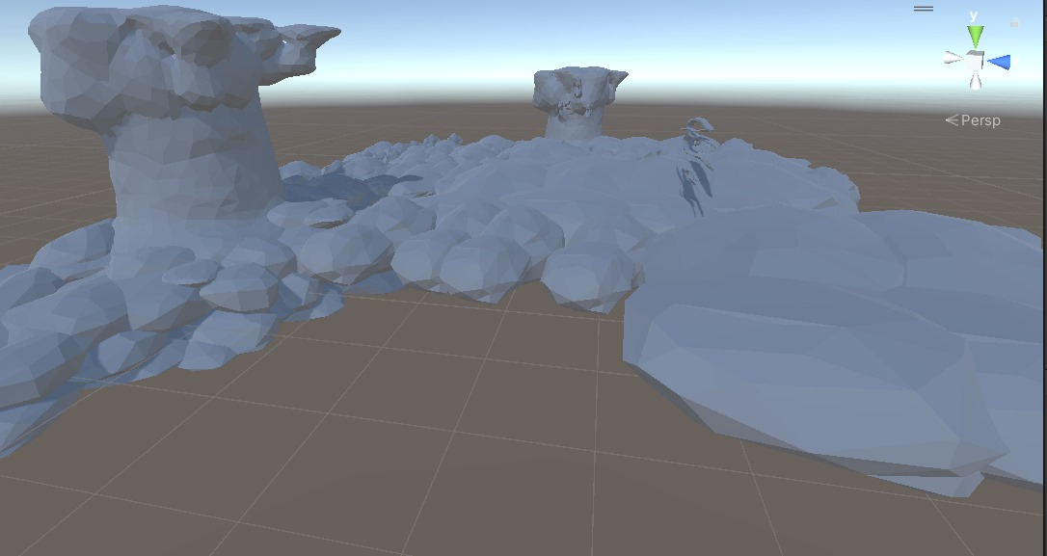
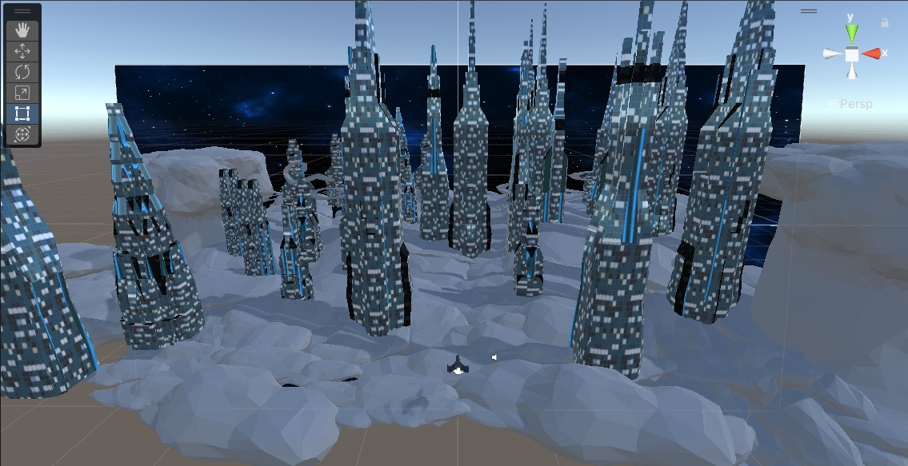
Now that the Game was developed and some progress is made. We thought of adding extra items and points into the game like a Timer that clicks down from 3..2..1..GO, and Achievements and Stores Menu. We also added a darkmode in the game where lights were set off making it even harder for the user to navigate. Aslo to add extra dimensions to the game we added the assest of Cloiuds inot the game.
The Two Modes- One with Lights on and One with Lights Off.
All the Assests that were used in making the game look good.

Slide 7
Non Player character in games :
The acronym "NPC" refers to non-player characters, an important aspect of most video games.
An NPC is any character not controlled by either the player or an AI, and can be an important character, or simply populate a game's world.
NPCs are different from CPUs, which are computer characters meant
to act like a real person.
Sadly we havent progressed enough into the game that we can add NPC into the game. Using NPC inlcudes ML for the game and that all can’t be inlcuded in the game we have designed.

Slide 8
Building UI Canvas
A canvas in a game is a graphical component that is used to render 2D or 3D graphics on the screen. It is a container that holds all the graphical elements of a game, such as images, text, and buttons. The canvas is responsible for rendering these elements in the correct order and position on the screen. It is also responsible for handling user input events such as mouse clicks and touch events ¹.
In Unity, a canvas is a component that is used to render UI elements such as buttons, text, and images. It is a fundamental part of the Unity UI system and is used to create user interfaces for games and applications ¹.
The canvas component in Thunkable is a touch-sensitive panel that enables the movement of items. It can be used to create a variety of games and experiences that
involve different methods of touching a screen ².

Slide 9
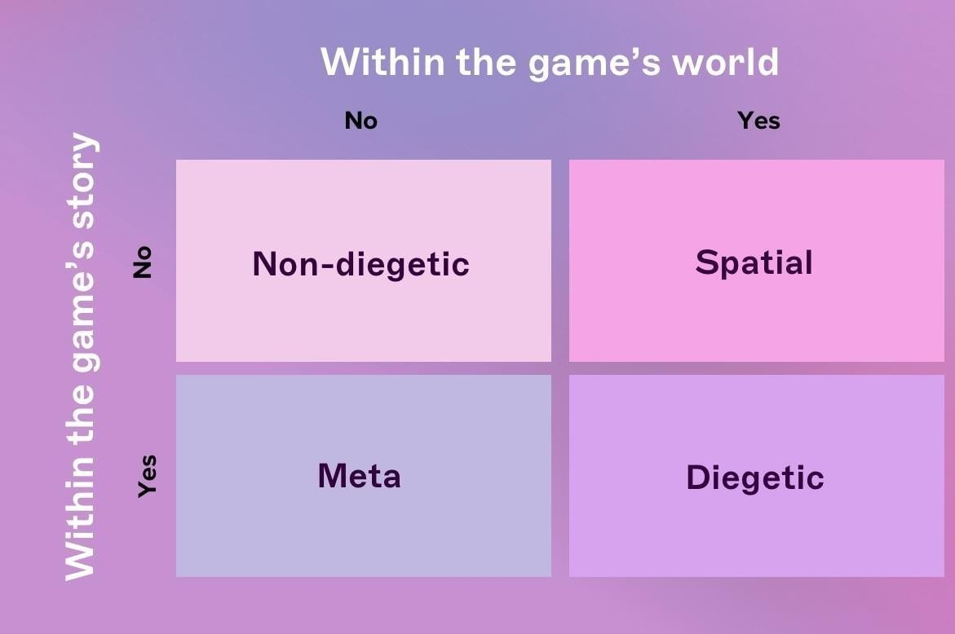
User Interface
Understanding interface components in game UI design
When it comes to game UI design, there are four types of visual representation: diegetic, non-diegetic, spatial and meta. To become a great game UI designer, you first have to understand what these mean and how you can use them effectively. Let’s break them down.
Diegetic: UI elements that can be seen or heard by the character and fit within the story’s context. Examples: a phone with a visible screen, holograms, and other futuristic gadgets.
Non-diegetic: UI elements that exist outside of the game or story and that only the player sees. Examples: menu screens, quest windows, and health bars.
Spatial: UI elements that are represented within the game space but aren’t visible to the characters. Examples: character outlines indicating who the enemies are, an arrow showing where a thrown object will land, and text labels.
Meta: UI elements that are contextual to the game but aren’t represented within the game space. Examples: scrolling text or colored overlays that indicate a change in the player’s health status.

